Slide 1
Core Competencies Self Assessments
Created at #BCEdChat on March 26, 2017

Slide 2
Core Competencies - Communication @vicki_den

Slide 3
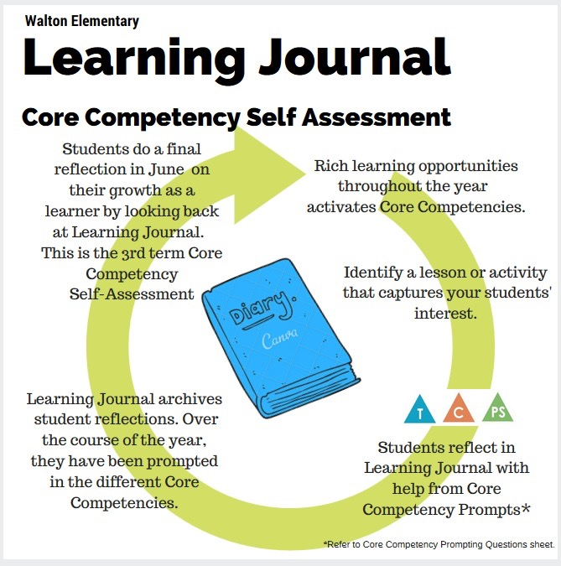
Learning Journal by @craigmah
The idea of the Learning Journal is for students to reflect on key learning throughout the year. At the end of the year, students will look back on their journal and reflect on their learning!
You can view the entire document with prompting questions here:
https://craigmah.wordpress.com/2017/03/24/core-competencies-and-reflections/

Slide 4
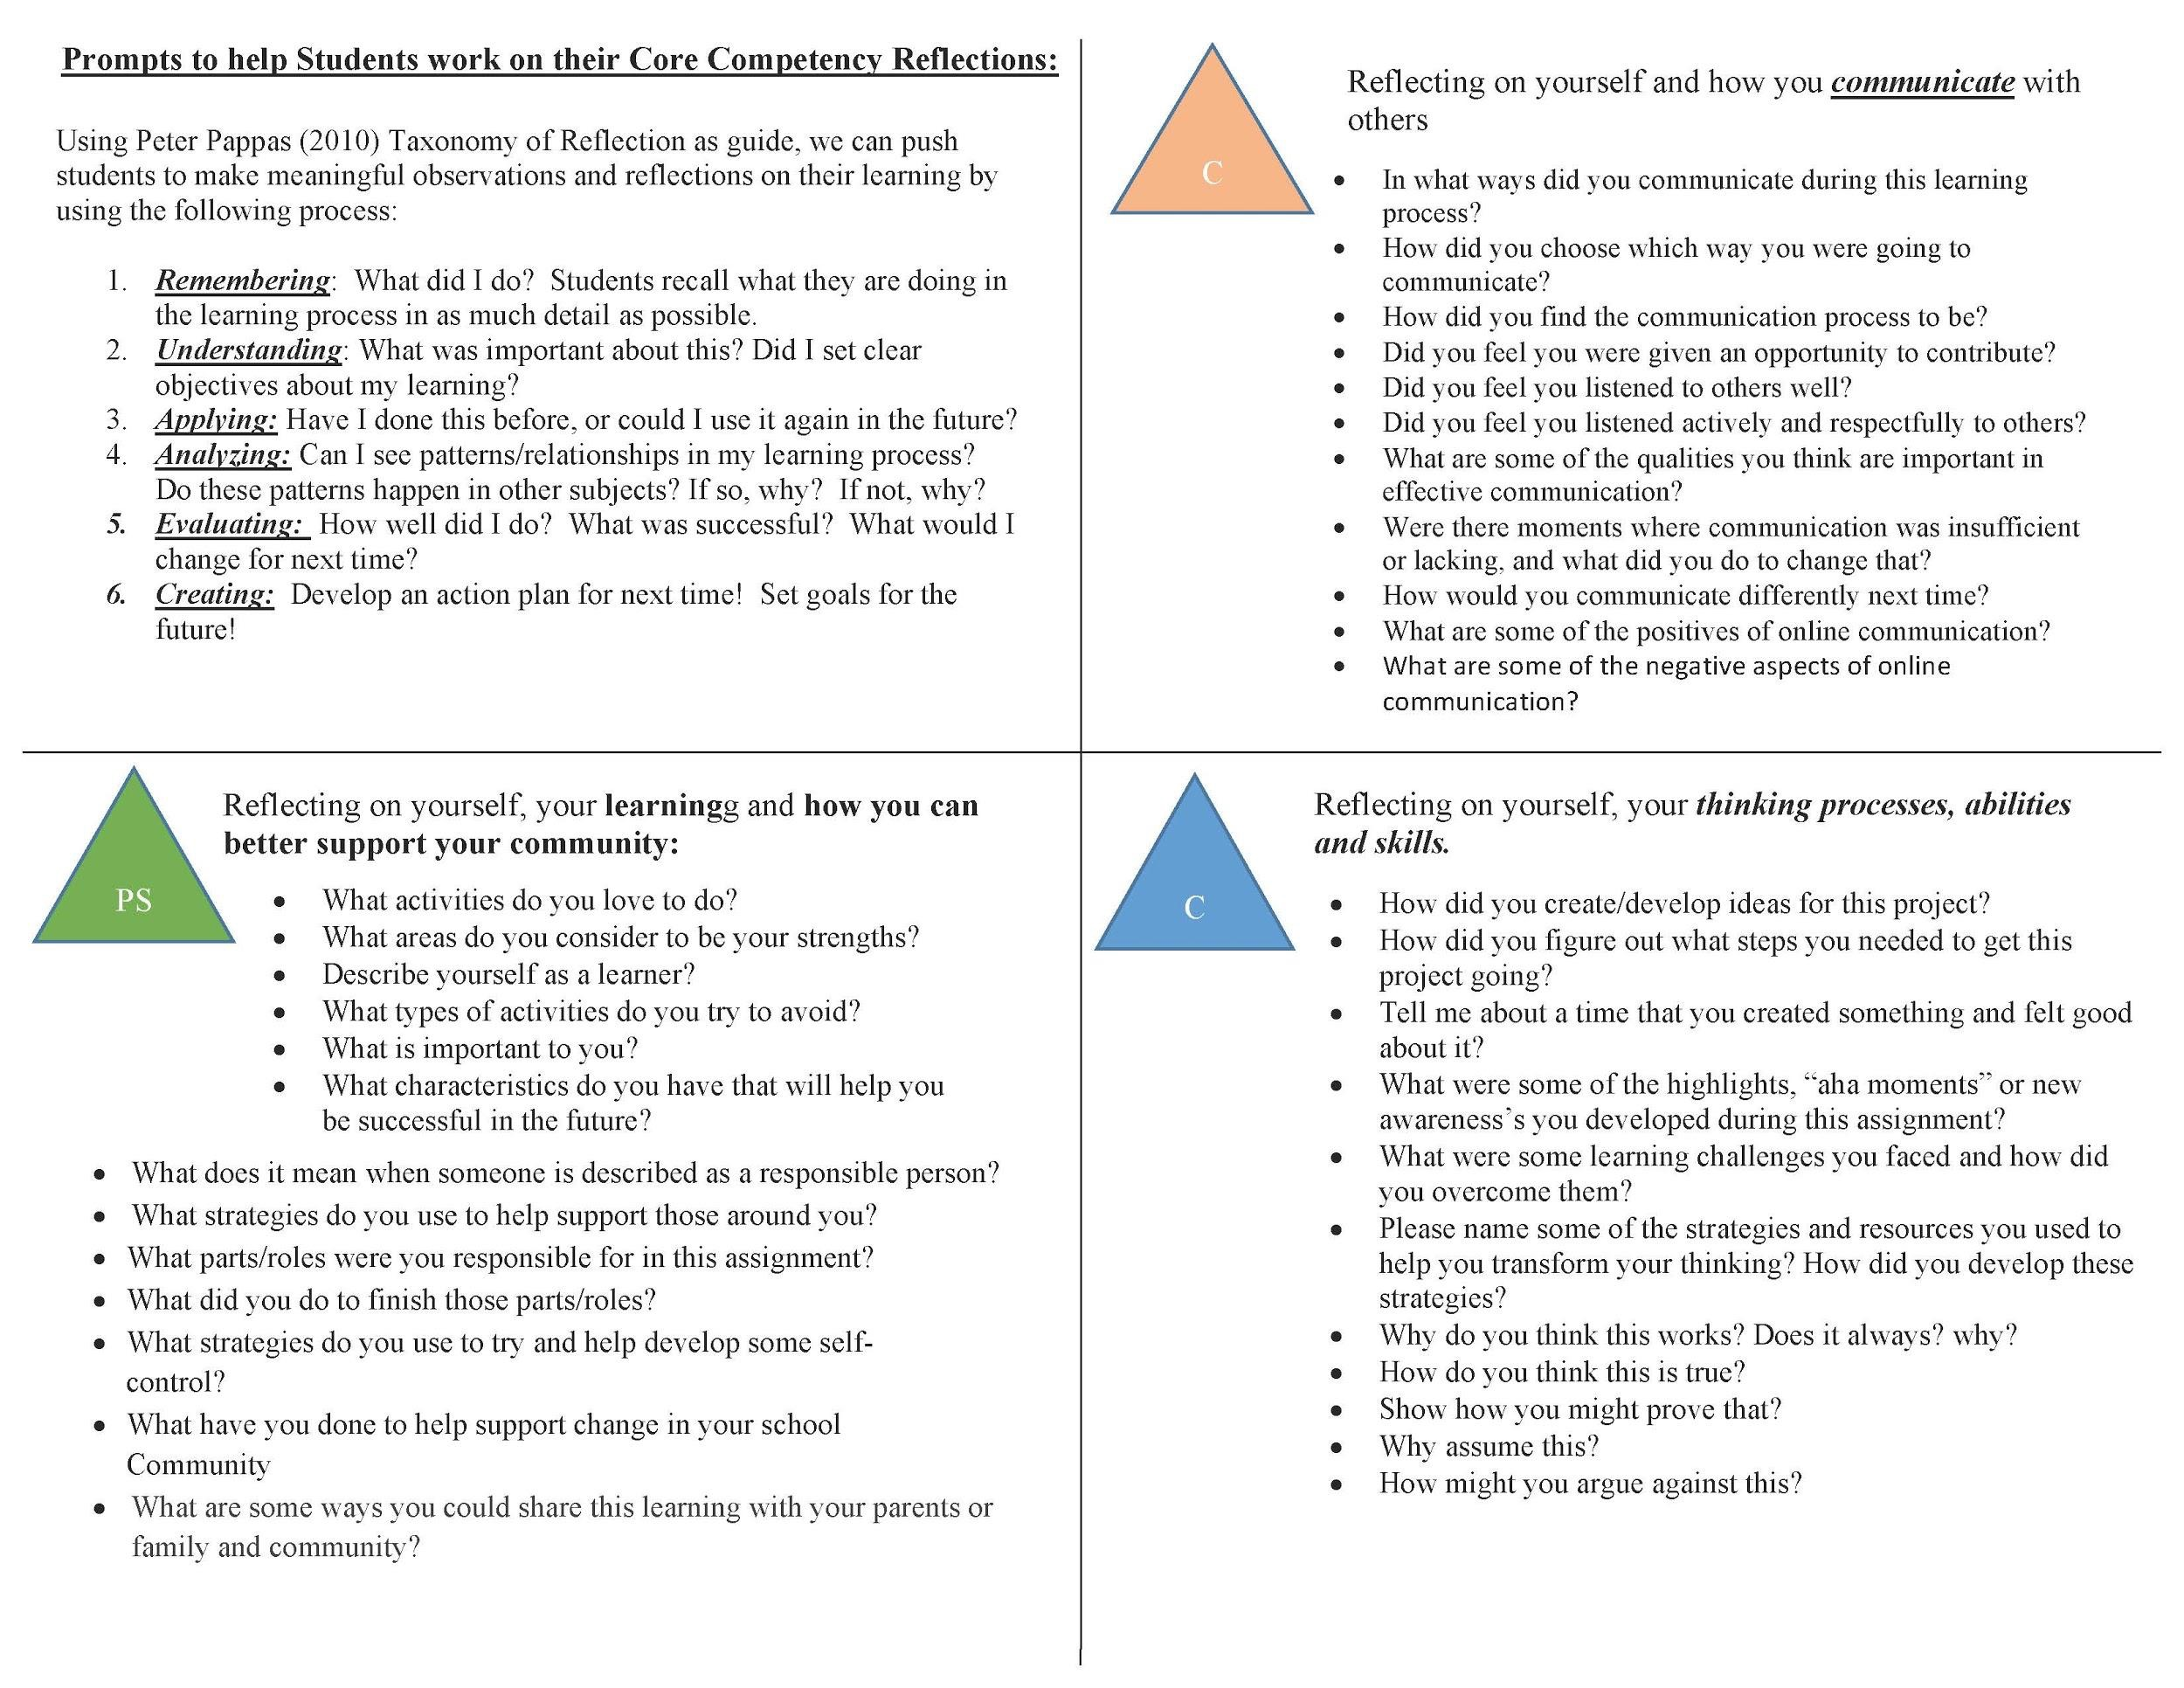
@KennethHeadley
The document on the next slide is just a support tool I created for my students to use so we can get them looking at questions that will push their reflections to be a bit deeper and more meaningful.

Slide 5
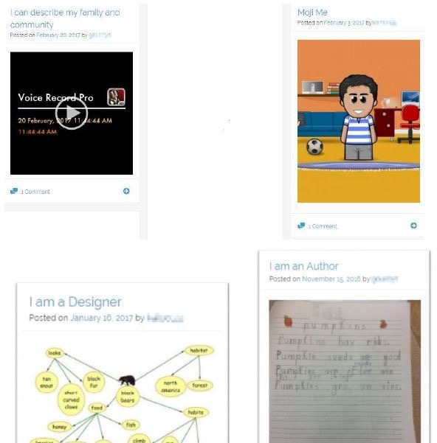
Student voice/not teacher (@JanetChowMSc)
Use an online eportfolio/blogfolio space to CAPTURE “I am..” statements. Student voice, not teacher’s voice. Take one area to compare over time. Link to term 3 report card.

Slide 6
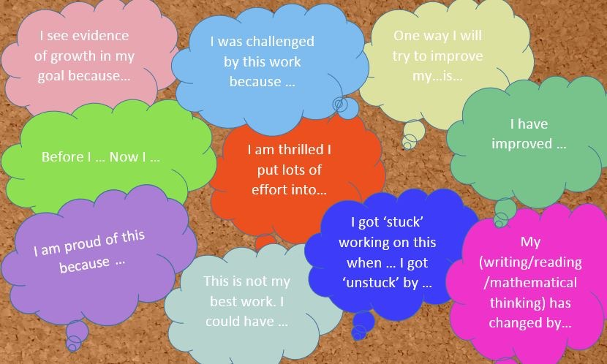
Prompting statements (I…) @JanetChowMSc
Bulletin Board questions as prompts for thinking about .. Students choose own activity, artifact or process to reflect (pre/post).

Slide 7
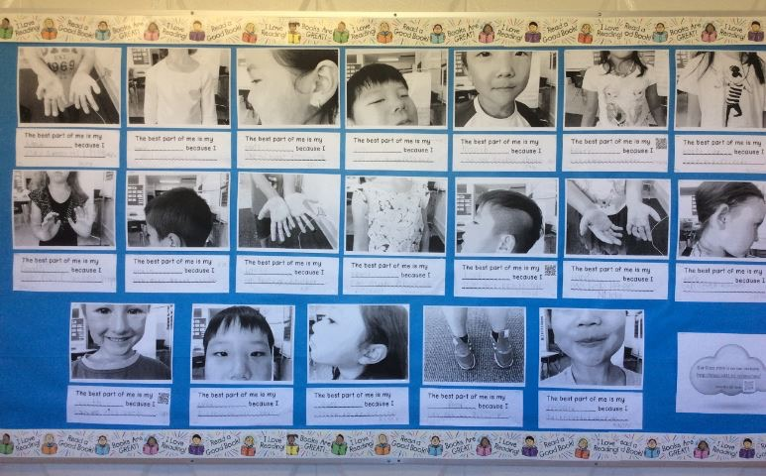
I Know Me - I Am A Thinker (@JanetChowMSc)
After reading “Wild About Us” by K. Beaumont, students chose to highlight their uniqueness in “My Best Part” with self photos in b/w. QR codes lead to voice recordings. See http://blogs.sd41.bc.ca/gourlays

Slide 8
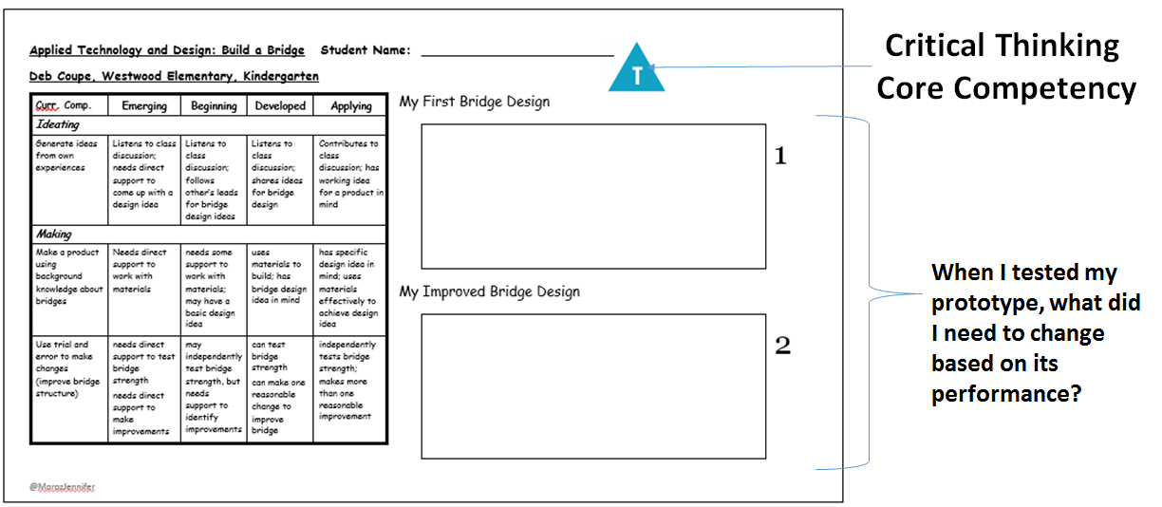
Competency assessment is embedded in meaningful learning @Moroz Jennifer

Slide 9
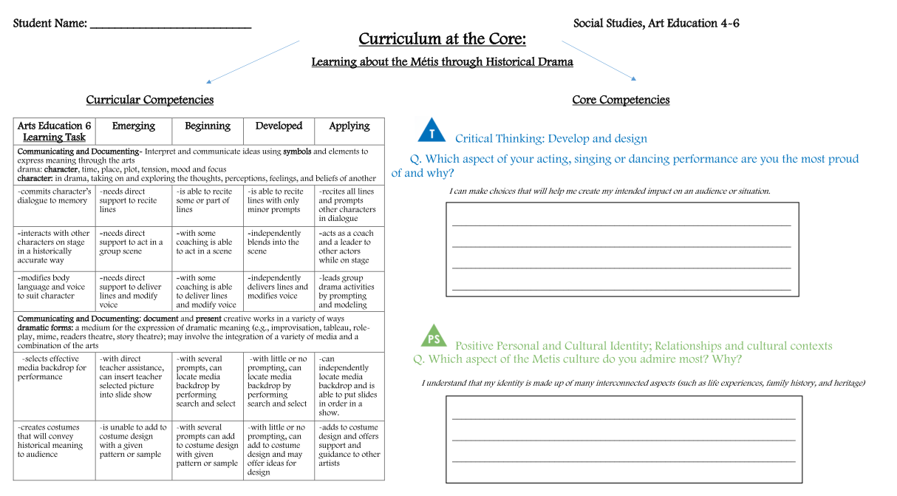

Slide 10
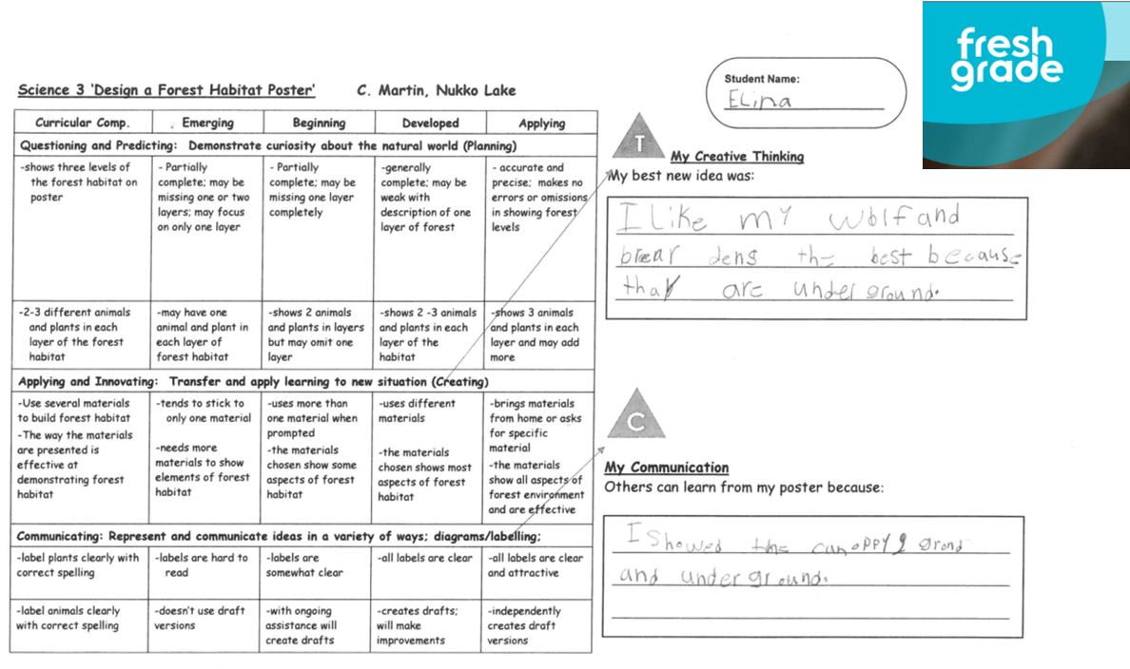
@MorozJennifer

Slide 11
@allison_burt
I would really like to see Core Competencies be used as ways for students to set goals for themselves. This means teachers need to help students understand the core competencies and draw connections for them, especially in the beginning, between what they are doing and what competencies they are developing/drawing on. This can be as simple as a reflection at the end or the beginning of an activity or assignment asking what competencies they were using. Which competencies do they feel most comfortable using? Which ones do they need to develop further?

Slide 12
@allison_burt

Slide 13
@sd36msjames
Building Core Competency Vocab in a hands on
& relatable way for students
We read, discussed, and brainstormed Personal Awareness and Responsibility Skills over the course of a week with the help of the book “One Smart Cookie”, we then practiced our skills and baked some cookies together. We created a learning story that we often refer to and remind ourselves about core competency goals and language. Students also complete Self Assessments on how they think they are doing in areas like organization, preparation/planning , teamwork, effective communication, personal awareness and responsibility.
Grade level: Intermediate

Slide 14
@sd36msjames
STEM Challenges
Creative Thinking- Generating Ideas and Plans
Critical Thinking-Developing, analyzing, and designing
Positive Personal & Cultural Identity- helps students recognize their personal strengths and abilities
Personal Awareness & Responsibility- Self Regulation
Social Responsibility- Solving problems in peaceful ways, & Building Relationships
Student Reflection Learning Journal Writing Prompts
What do you think was the purpose of doing this stem challenge? How could this challenge apply or be use in a realistic situation?
What was your design or plan? What were the materials you used in your project?
If you worked with partners or groups, evaluate how well you cooperated and worked together as a team? How was your communication?
What surprised you about this challenge? What if any frustrations did you have with this challenge?
What did you notice in the designs that worked well, and didn't work well?
In your next design what would you do different, want to try or change about the challenge?

Slide 15
@MmeNero
I have been working with teachers to use manipulatives in the classroom for students to communicate in their L2+ Station ideas PDF: http://bit.ly/languagemanipulatives
Example of a reflection station:
Giving TIME for students to reflect on the Core Competencies & providing evidence in their digital portfolios
Stations give students the opportunity to communicate authentically and develop their creative & critical thinking skills. While PLAYING in the secondary level, students are developing their personal and social responsibility competencies to collaborate and take risks in their L2.

Slide 16
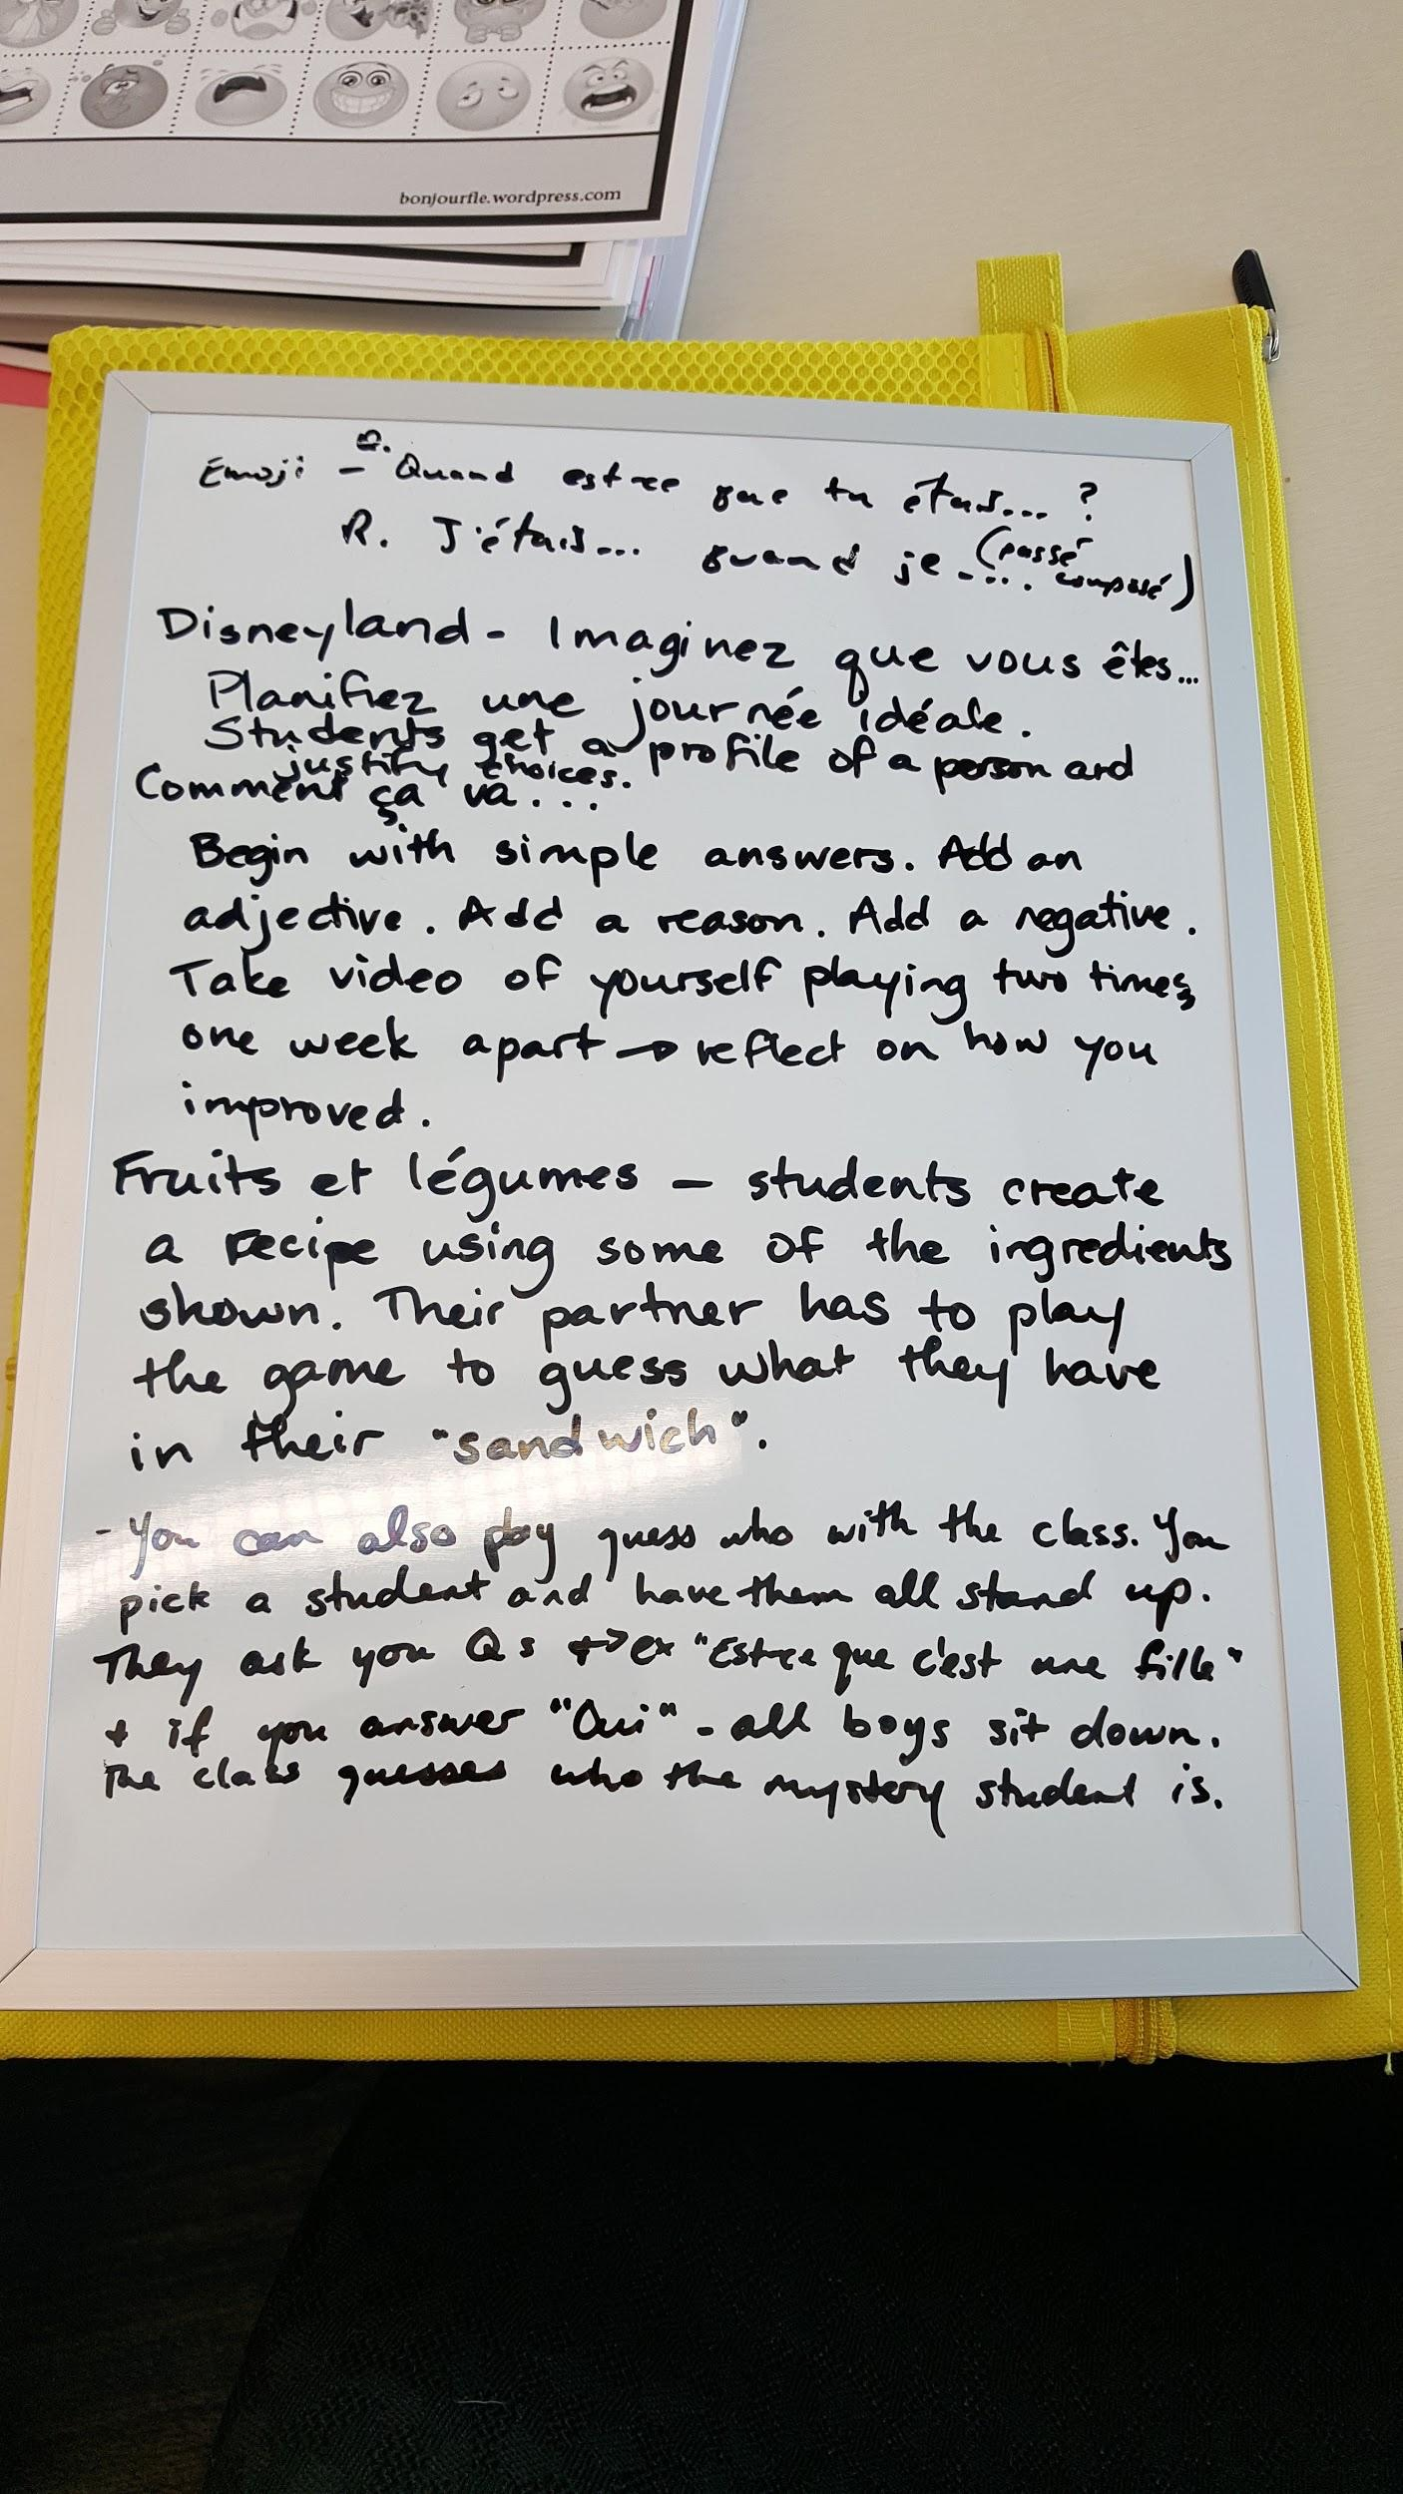
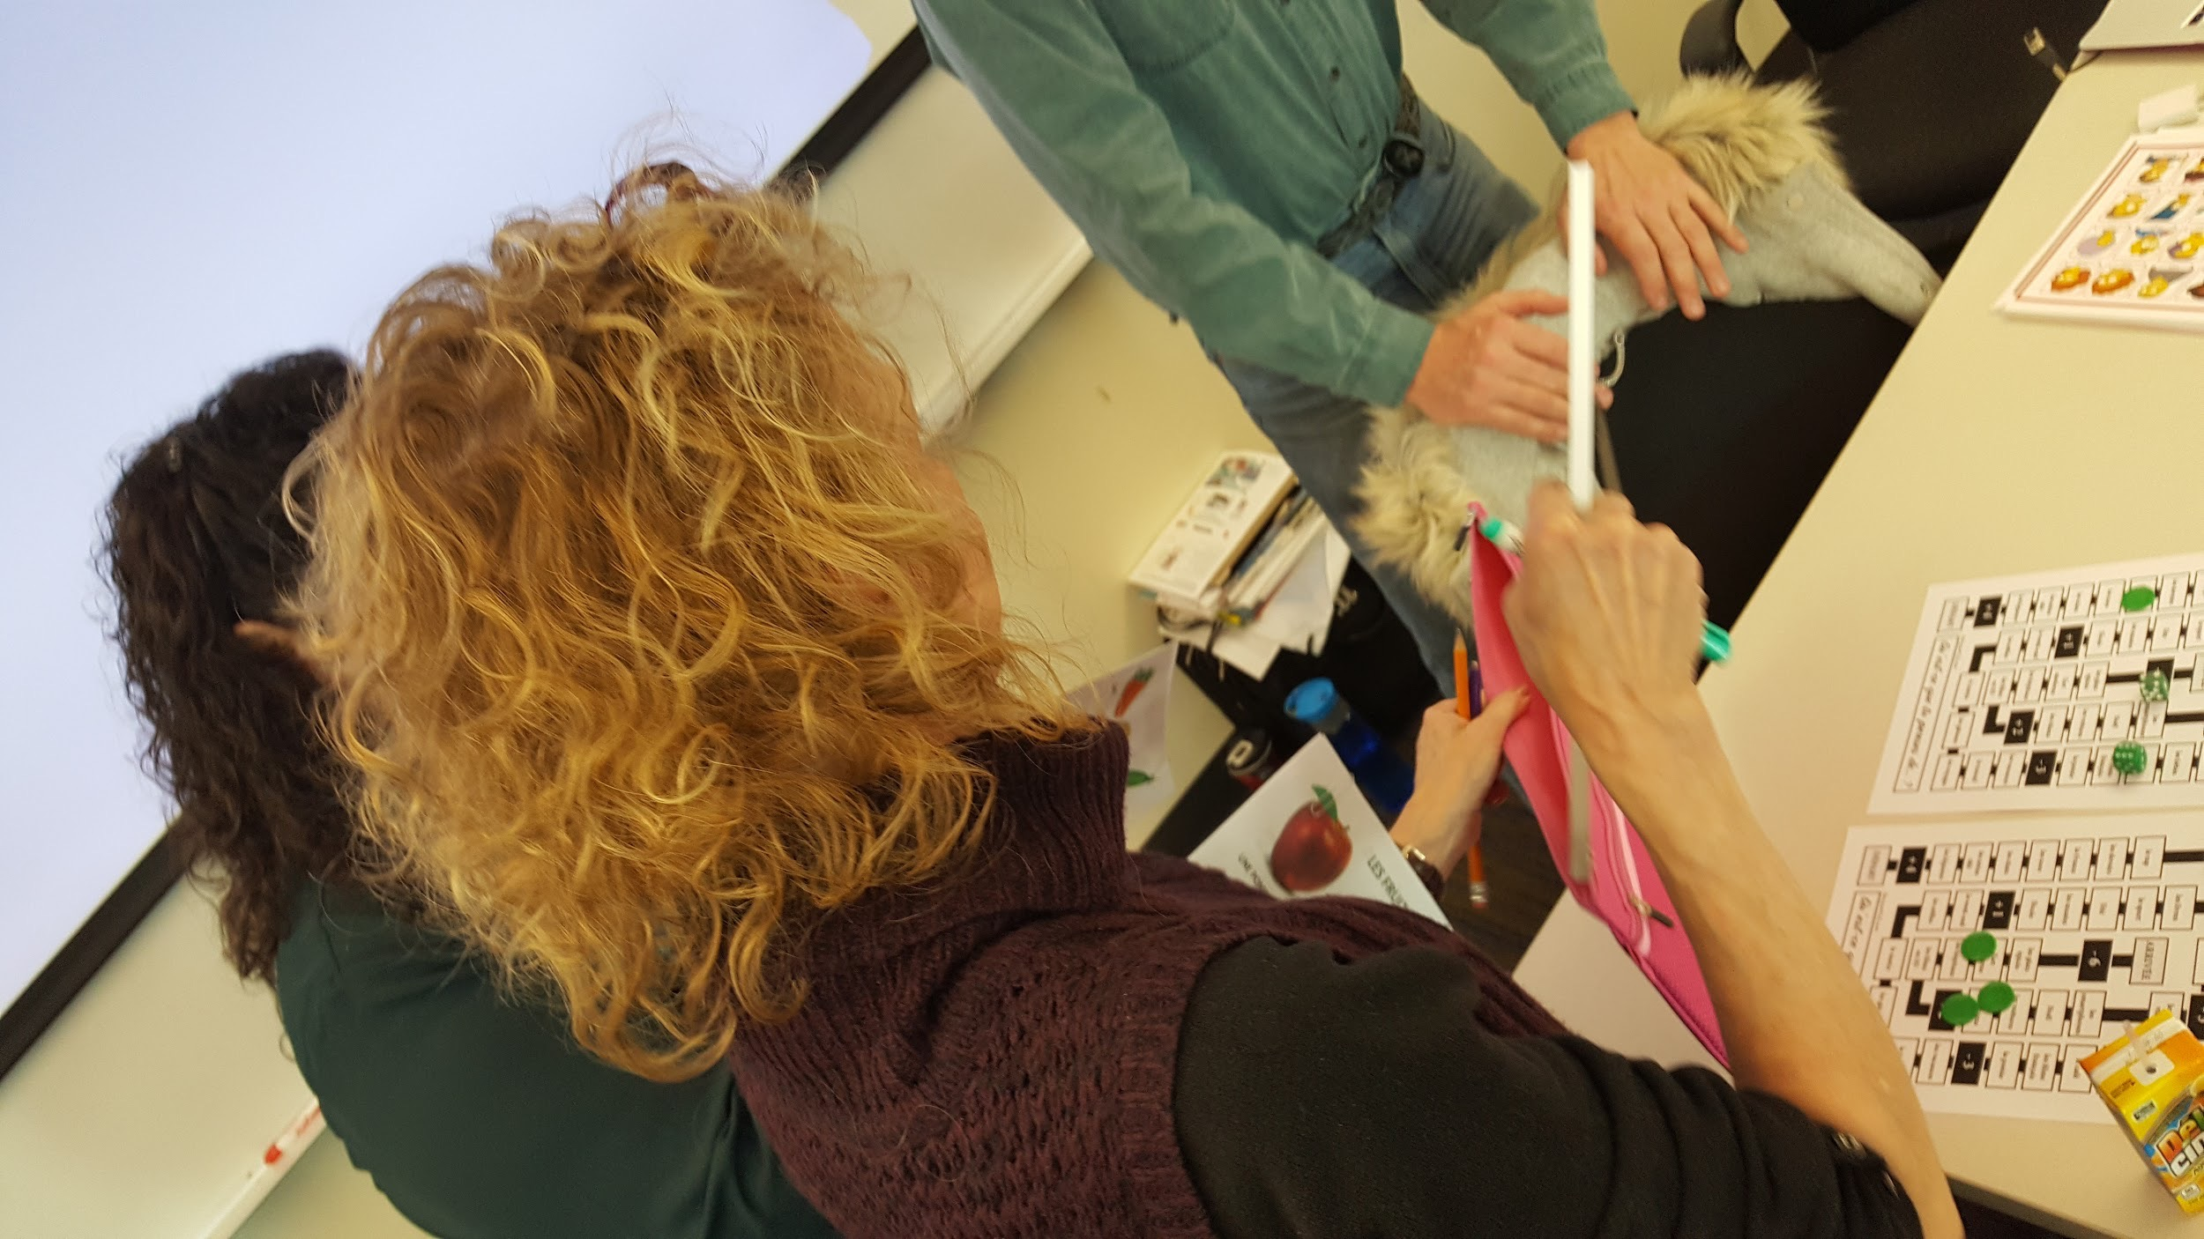
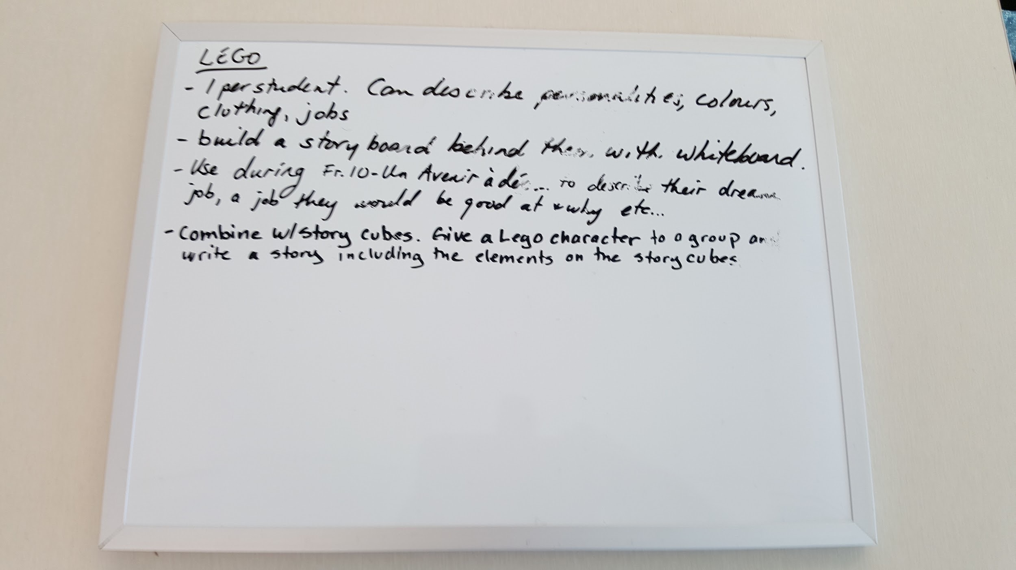
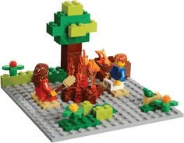
@mmenero
Ex. In what ways can students tell a story using whiteboard backgrounds and Lego in L2?
Teachers have been collaboratively adding their ideas by writing them on the provided whiteboards as they experiment with the materials at teach station. These whiteboards are useful for students so that students can collaborate and share their questions/connect their learning to the Core Competencies while they are learning.

Slide 17
Core Competencies Frames (@JanetChowMSc)
Link to sd41 District Learning Technologies site on Core Competencies:
http://blogs.sd41.bc.ca/learningtech/new-curriculum/core-competencies/

Slide 18
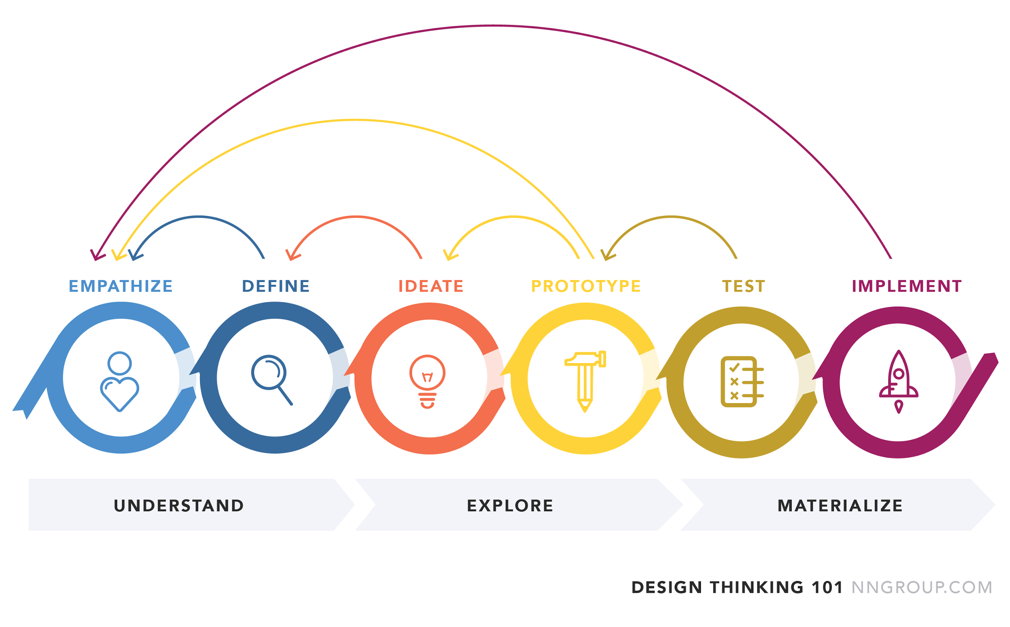
@|*LisaRead*| says: It’s all by Design (Thinking)
#sd79learn we are deep-diving into looking at Core Competencies under the umbrella of ADST. The ability to ask the empathetic question is governed by the ability to relate to personal social responsibility. Ideating and Prototyping? All the domain of creative thinking. Testing, Reflecting and Defining are all possible thanks to Critical Thinking. Implement=Communicate

Slide 19
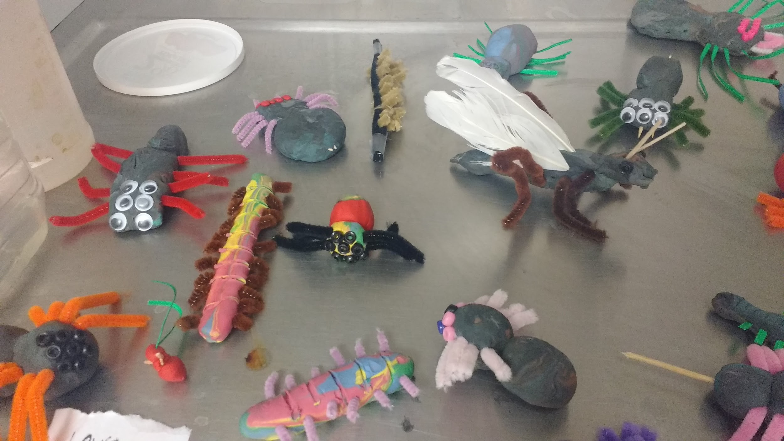
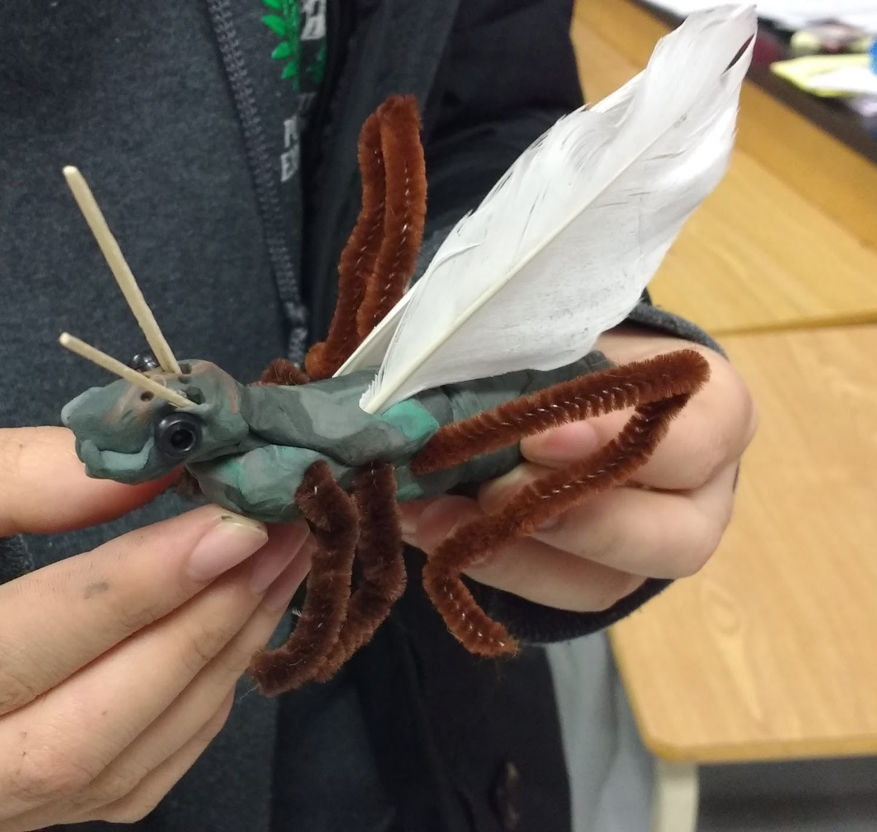
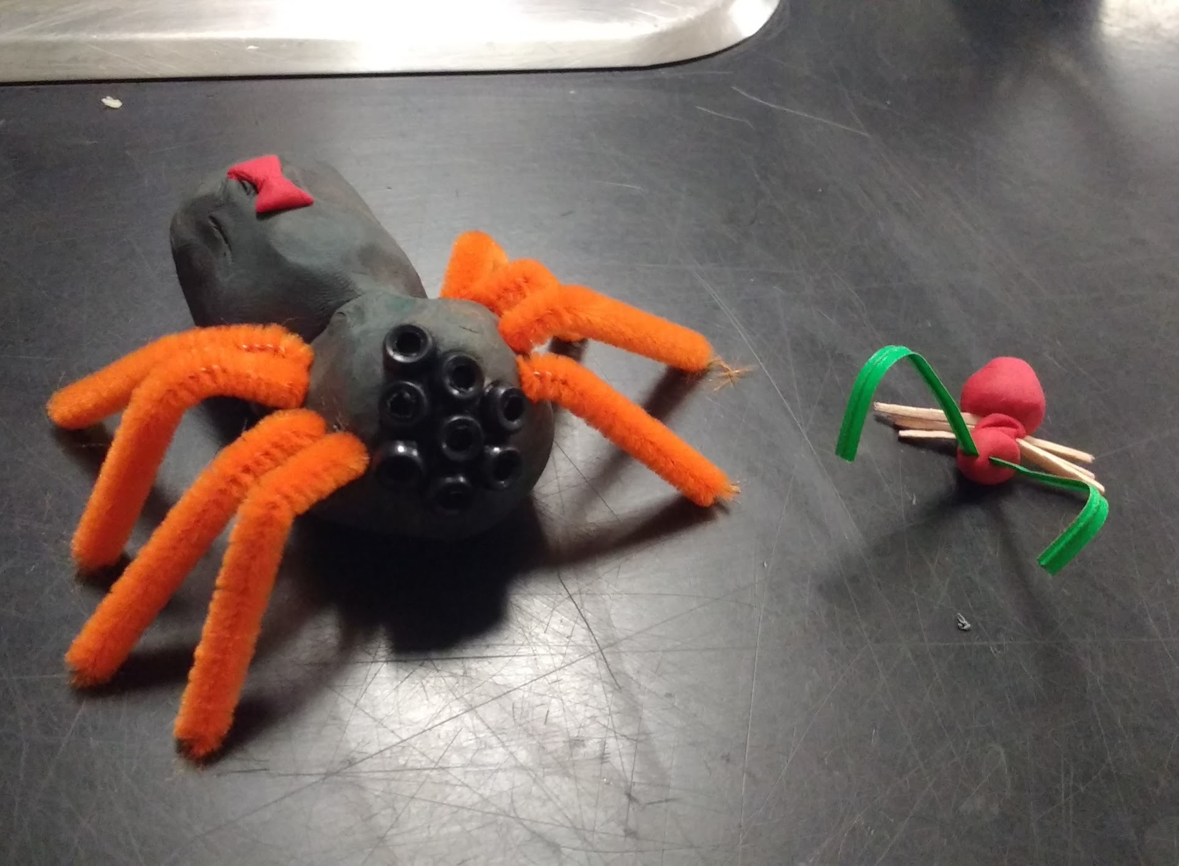
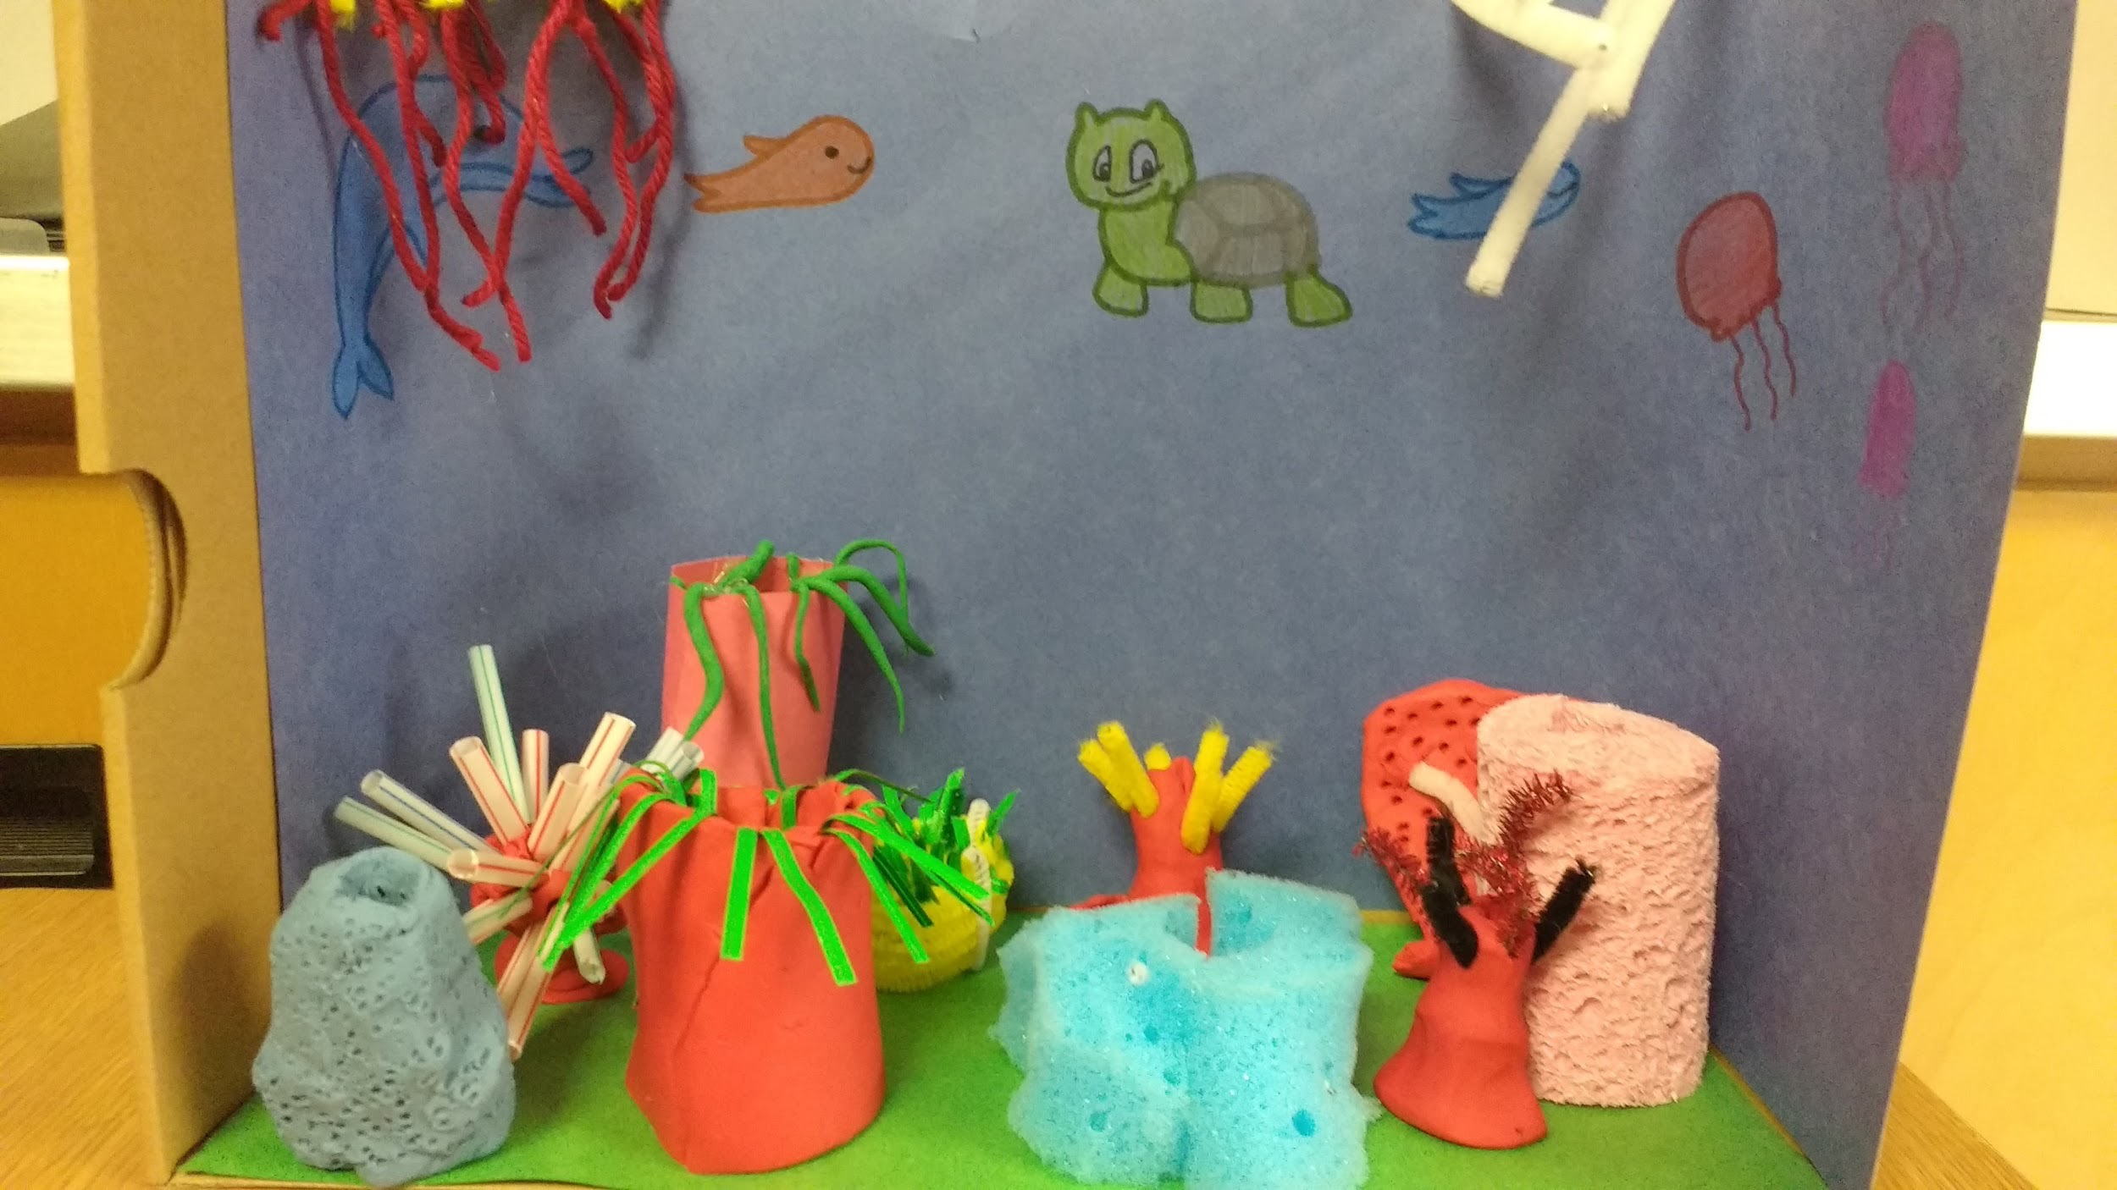
@brark
Biology 11:
Using Models to Communicate Understanding of Core Concepts
Opportunity to quickly fix misconceptions, allow for creativity, and give time for hands-on learning and expression of understanding

Slide 20
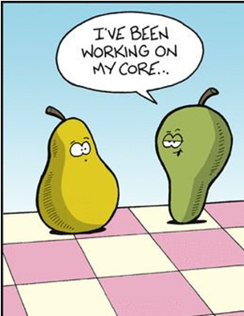
@rosepillay1
Ask Not “Are you…?” But “How are you …?” so students can answer “Who are you?”
Metaphors & Analogies for Core Competencies:
At the Core
Yearbook
Crayons
Glow
“The Core Competences are NOT ‘outcomes’ and the profiles are NOT ‘requirements’. They are NOT ‘another curriculum’ or a ‘competing curriculum’. These are NOT standards for judging or comparing. It’s not about filling in a template or checking off aspects on a rubric. “
– Dr. Sharon Jeroski

Slide 21
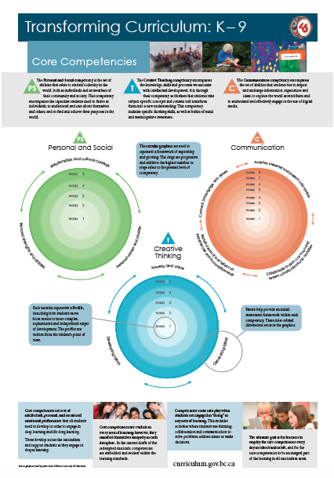
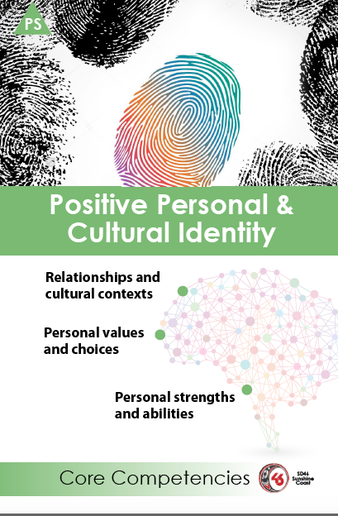
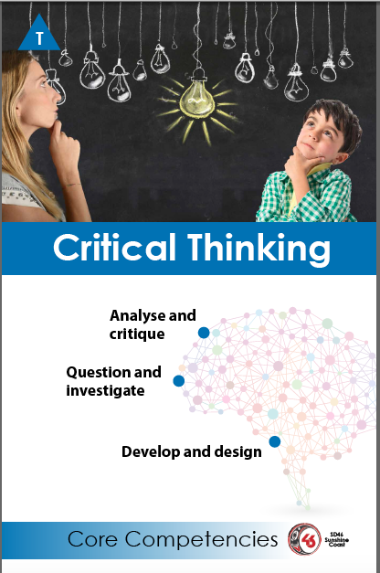
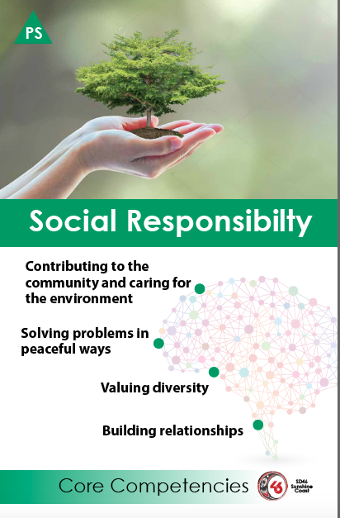
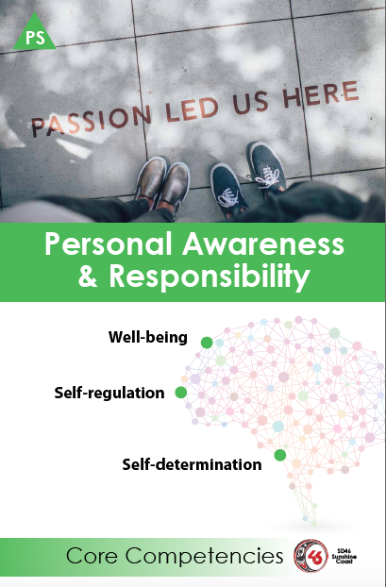
@davidbarnum
We will have these done shortly. They print 11 x 17 and are meant to prompt discussion in classrooms so that students create their own “Looks Like/Sounds Like” versions of Core Comps. The poster was done last year when they draft documents were being referenced. I might update it. If you are interested get in touch early April dbarnum@sd46.bc.ca

Slide 22
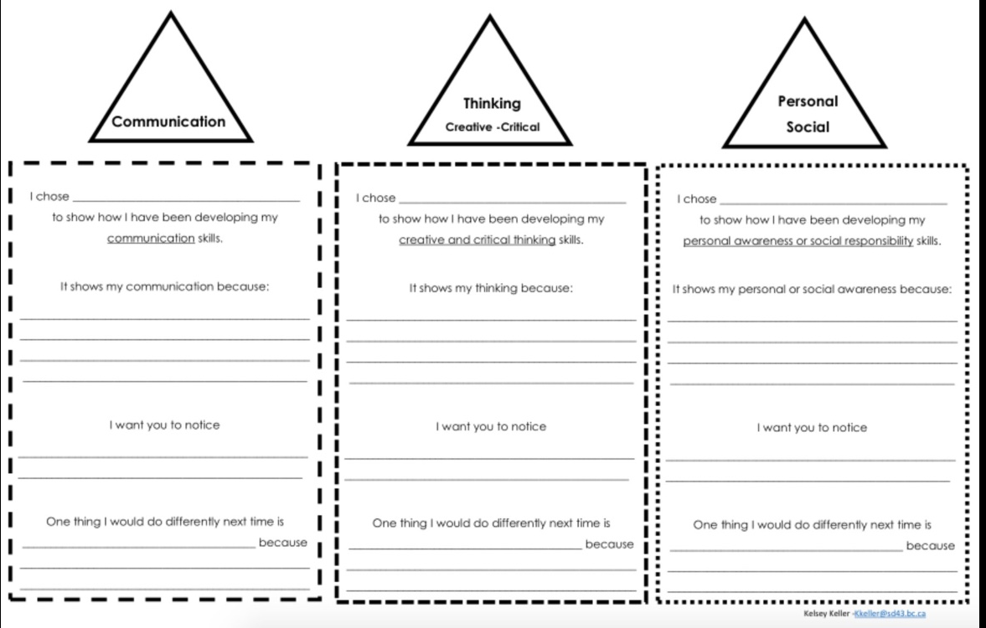
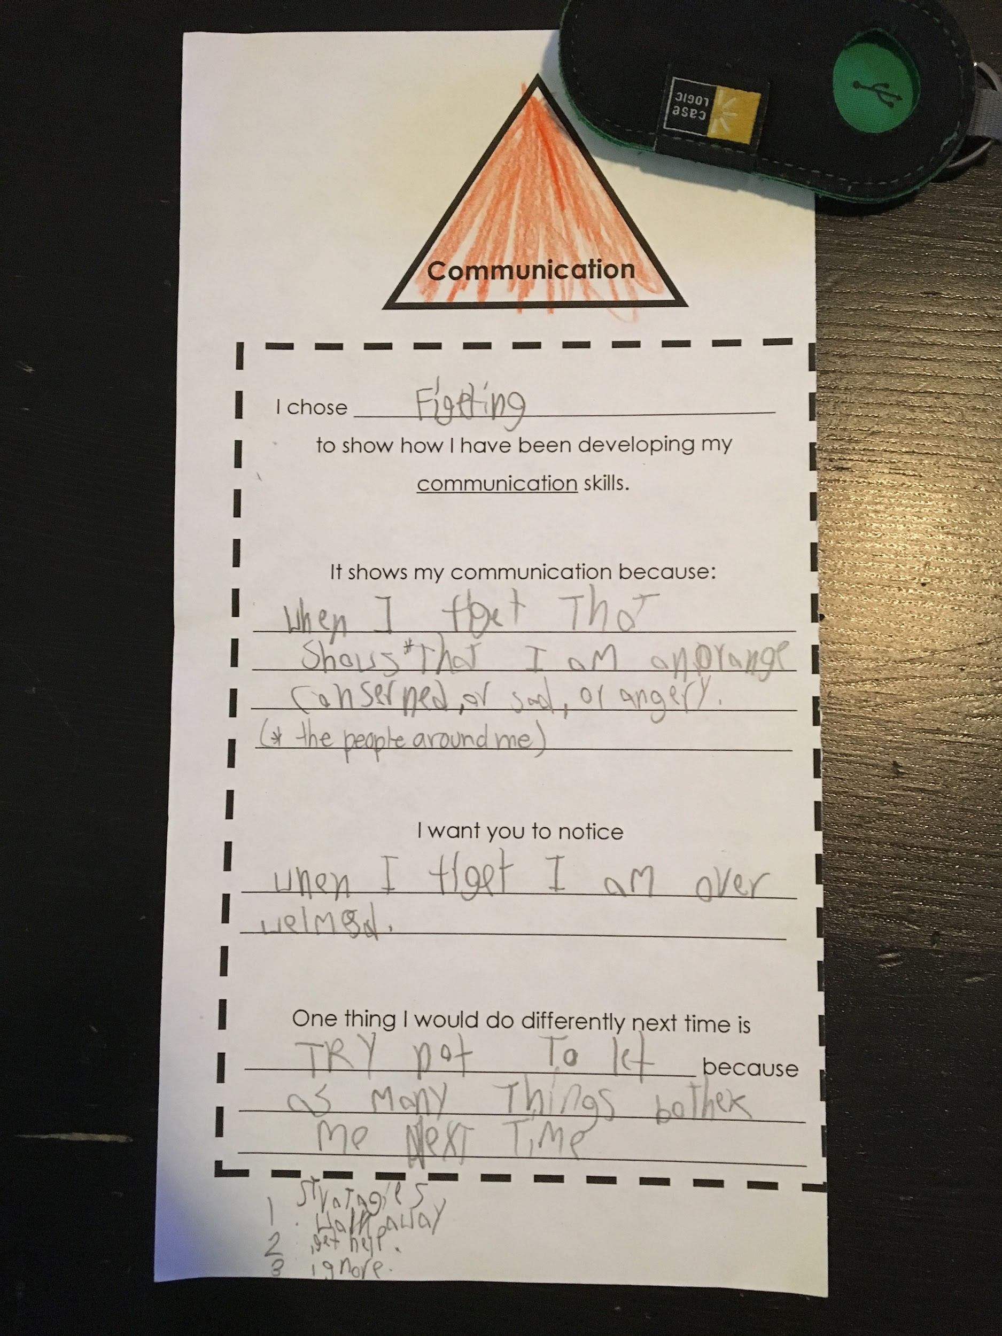
@montessorimice (Kelsey Keller)
#1 Choosing artifacts to show how they are developing CCs. Rooting the CCs in something concrete help make abstract ideas more accessible.
#2. Justification - its shows ___ BECAUSE…
#3. I want you to notice - an opportunity to enlighten the teacher.
#4. Strategic action planning - what would you do differently next time?

Slide 23
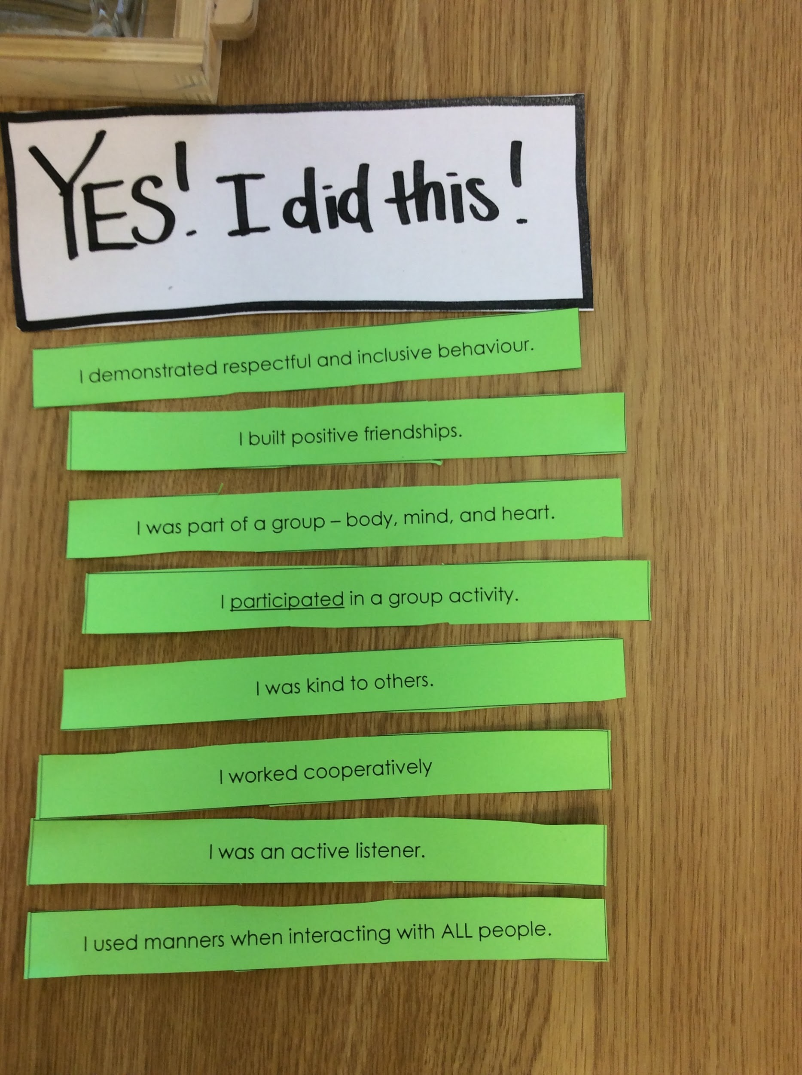
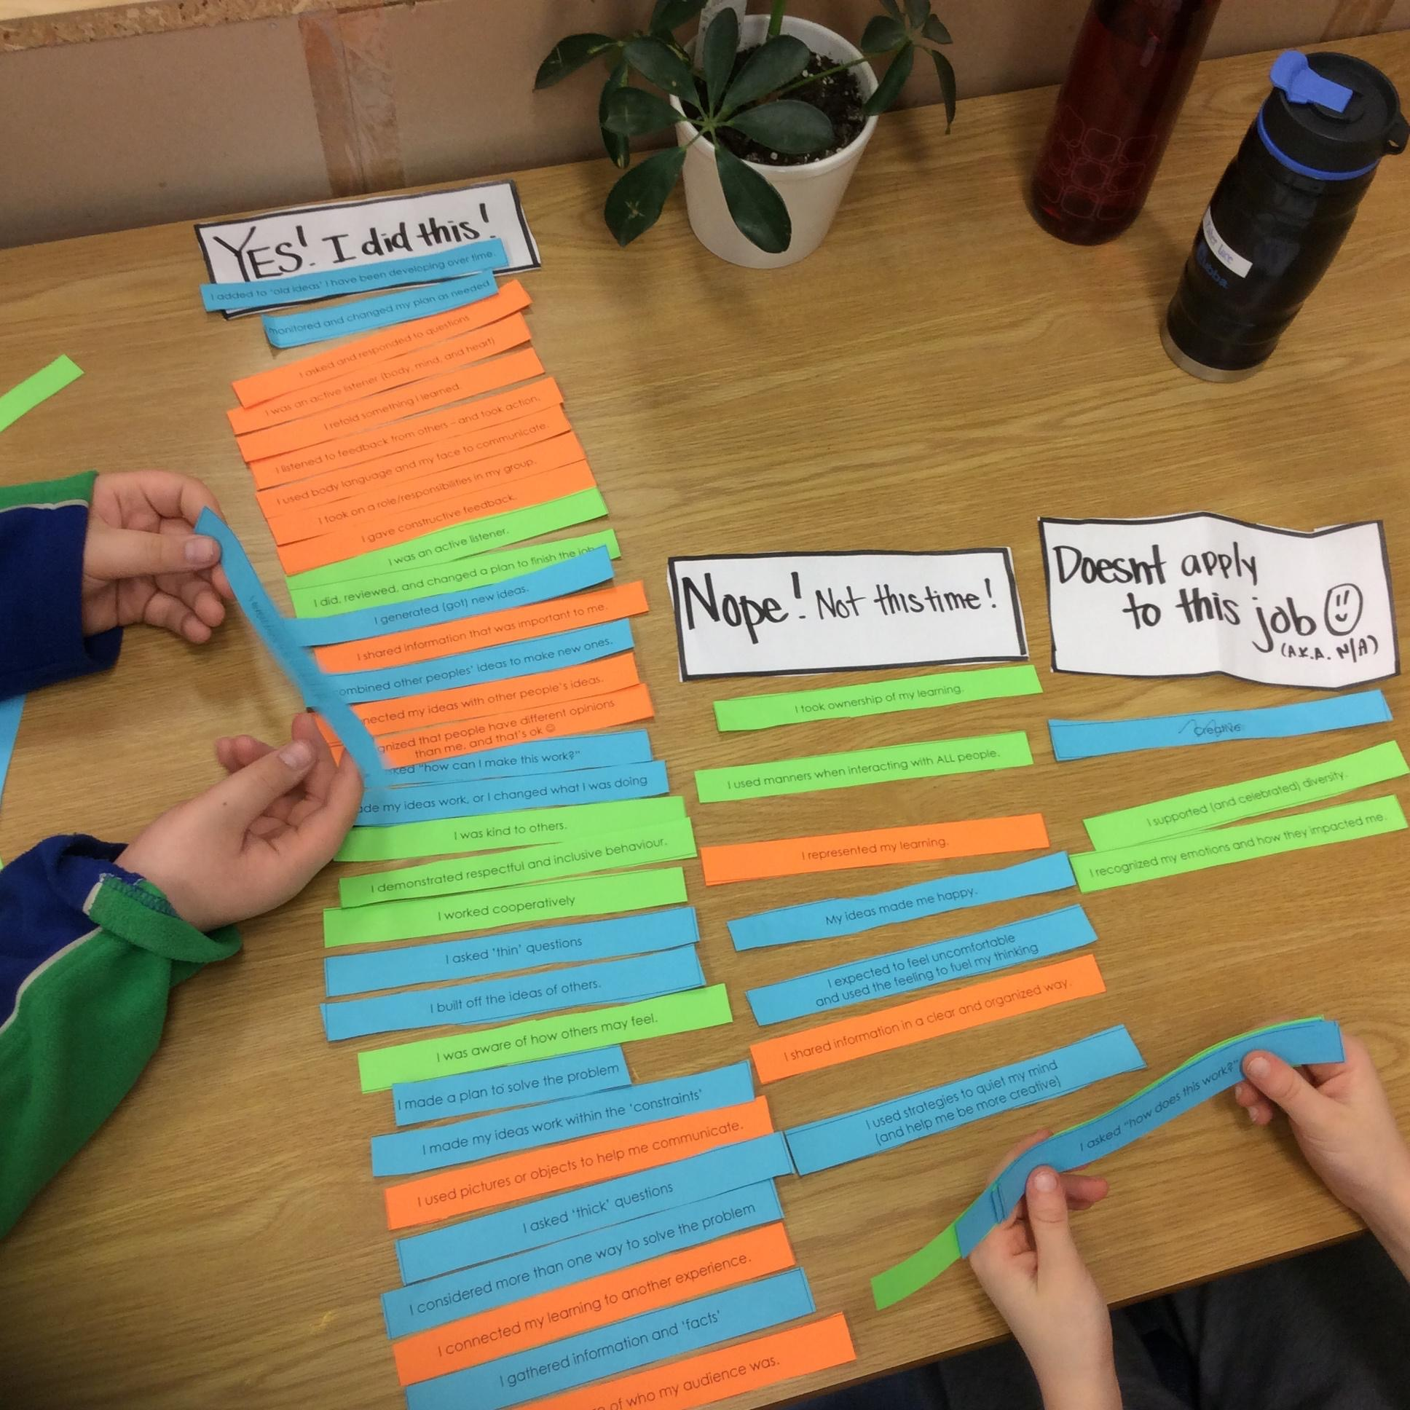
@montessorimice (Kelsey Keller)
After an activity (anything really!) the kids are invited to reflect on what CCs (specifically i-statements) they utilized, those they did not, and those that were N/A for a particular activity.
There is no ‘wrong way’ to sort them as long as they can justify WHY they put them in a particular column. Once done, the kids make observations “Oh wow, I REALLY needed to communicate to do this, I used ALL the communication statements” or “I used a lot of critical thinking but not a lot of creative thinking, hmm”. In the example we used all 3 of the CC triad but I’ve also focused on just one area too in order to provoke students to examine one area more deeply.
This helps them SEE how they used the CCs, while at the same time helps them internalize and USE the CCs language independently (builds a common language).

Slide 24
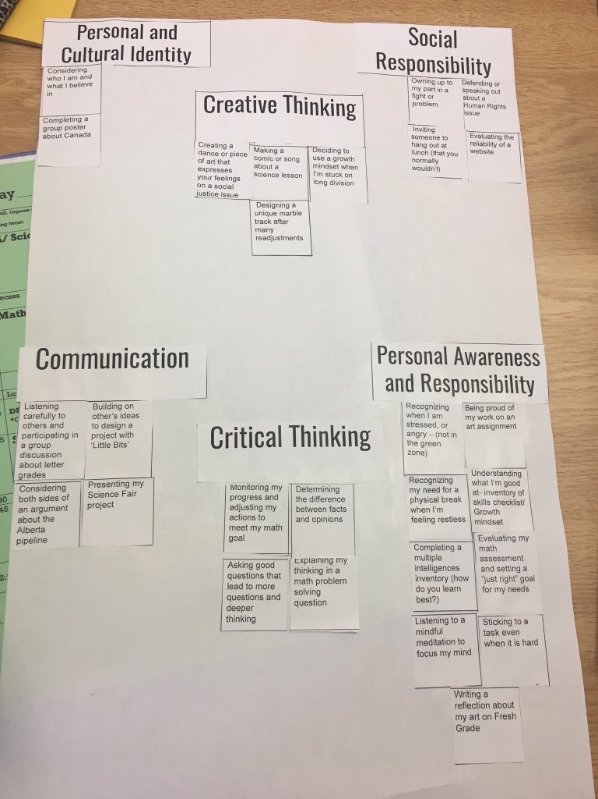
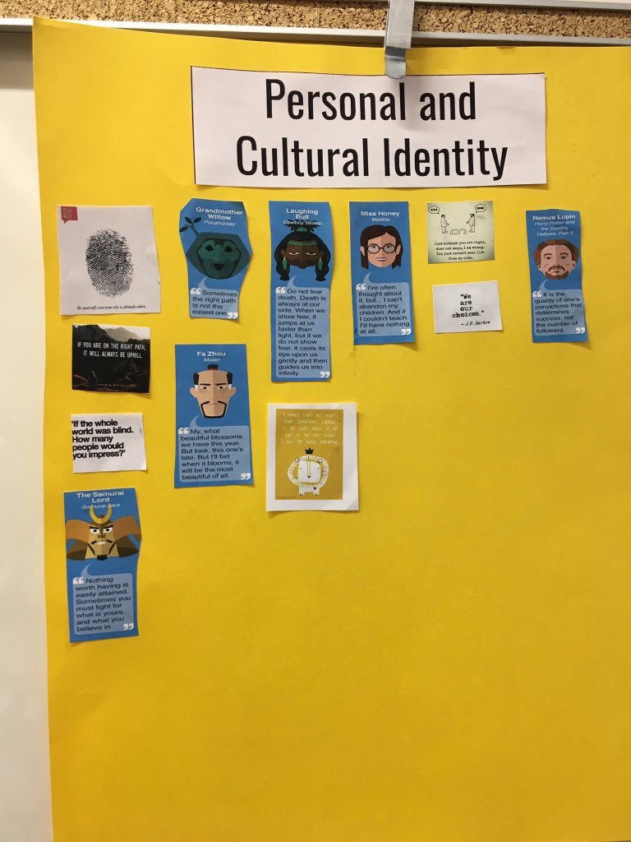
Kristin Visscher @Visschinspired
They are both sorting activities to introduce the 6 areas. 1 is famous quotes ( also in the google share drive) and another is just some of our classroom activities- both create great discussion! For graphics: https://t.co/0jxBhBkXXn

Slide 25
Using Images that speak (@JanetChowMSc)
Focus is on including images to support any text. Photos/images are selected from deep thought usually by reviewing lots before selecting the few that really offer a statement of learning.

Slide 26
@vwoelders Victoria Woelders (Langley School District)
I have been using a video collection through my YouTube playlist to bring discussion into my classroom on the Core Competencies. I also use #projectinspirekids on Twitter.
I have put one of my favourite videos here on Gratitude.
Click below to see videos playlists:
Personal and Social Competency (30 videos)
Communication Competency (11 videos)
Thinking Competency (25 videos)

Slide 27
Resources from SD62 Learning Commons
http://learningcommons62.sd62.bc.ca/files/2016/12/Core-Competencies-Self-Reflection.docx
http://learningcommons62.sd62.bc.ca/2016/12/07/core-competency-ideas/

Slide 28
@vwoelders Victoria Woelders (Langley School District)
I have been working on report card comments to focus primarily on Core Competencies. In Langley, we are not expected to put Core Competencies in report card comments for Term One or Term Two, but I felt I wanted to professionally work towards all my curriculum content focusing on these. Instead of hoop jumping through content, I wanted the core of my teaching to be evident that it was the Core Competencies. I saw an example in the Fall somewhere, and I used it. Here one of my examples for Term One.
This student is a respectful and kind student, who is meeting the expectations for the Grade 4 curriculum. As a Communicator, he is at the Grade 4 level for his Speaking, Reading and Writing. We encourage him to develop his Writing skills by enhancing his descriptive language. He used Critical Thinking skills to meet expectations in the areas of Patterning, Place Value up to 10,000 and Problem Solving. He demonstrated Creative Thinking in his STEM Arcade Game, and met curricular expectations. He developed his Positive Personal and Cultural Identity through his understanding of Peace Circles, McClughan Park walking field trips and Aboriginal Peoples studies. His Personal Awareness and Social Responsibility should be commended because he demonstrates kindness and gentleness to others in and out of the classroom. For next term, he would like to develop his ability to complete work on time, and his practice neatness. Keep up the good work, it continues to be a pleasure to teach you.
I also think by trying to see my teaching practice as the Core Competencies, it will help me in the future mould, create and empower kids in different ways. This is in no means perfect, but it does help me stay focused on what is at our Core.

Slide 29
Core Competency and Self Assessment from @bcedplan
Core Competency Poster
https://curriculum.gov.bc.ca/sites/curriculum.gov.bc.ca/files/pdf/Core_Competencies_Posters.pdf
Supporting Documents
https://curriculum.gov.bc.ca/sites/curriculum.gov.bc.ca/files/pdf/supporting-self-assessment.pdf

